Slide 1
NFCSD P-TECH(Pathways in technology early college high school) Parent information night
P-TECH Mechanical Technology/Engineering
P-tech computer Information Systems/computer science
Spring 2025

Slide 2
Welcome and Introductory remarks
Mr. Laurrie – Superintendent
Mr. Carella Assistant Superintendent for Curriculum and Instruction

Slide 3
NFHS Pathways Programs- Mr. Rotella
COMPUTER SCIENCE AND INFORMATION TECHNOLOGY
BUSINESS, FINANCE, AND ENTREPRENEURSHIP
Entrepreneurship
Management / Leadership
Marketing / Hospitality / Tourism
Computer Science
Full-Stack Development (Coding / Game Design)
Computer Technology
Graphic Communications
Web Development and Game Programming

Slide 4
NFHS Pathways Programs
DESIGN, ENGINEERING, AND CONSTRUCTION TECHNOLOGY
HUMAN SERVICES
Education
Humanities
Law
Medical / Nursing
Security / Law Enforcement
SW/MH Counseling
Allied Health
Animal Science
Certified Personal Trainer
Cosmetology
Early Childhood Education
Emergency Medical Services
Health Occupations Technician (HOT)
Advanced Manufacturing
Bio / Environmental Engineering
General Construction
Mechanical Technology (PTECH 1)
Mechanical/Engineering Science (PTECH 1)
Auto Body
Automotive Technology
Building Maintenance and Management
Conservation
Diesel Technology / Heavy Equipment
Electricity / Electronics
Heat / Ventilation / Air Conditioning (HVAC)
Project Based Engineering
Welding

Slide 5
NFHS Pathways Programs VISUAL AND PERFORMING ARTS
Media
Music Performance (Instrumental)
Music Performance (Vocal)
Music Production
Theatre Arts
Visual Arts
Animation and Video Production
Fashion Design and Interior Decorating

Slide 6
P-TECH Program Summary
P-Tech is a grant-funded program that recruits students in the 8th grade into one of two pathways that the NFCSD offers in Mechanical Technology and Computer Science
Students start the program by engaging in a summer camp after grade 8, then follow a course sequence throughout high school which includes dual enrollment/college credit classes
Students can earn their Associates degree in 4-6 years at no cost – all tuition is paid through the grant.
We work with our higher education partner SUNY Niagara and our local business partners to make this program possible
Students engage in Summer Camp, College Classes, College and Career workshops, Fieldtrips, a speaker series, college planning, job shadowing and internships throughout their high school career. Students will have opportunities to interview with local businesses for jobs in their respective fields

Slide 7
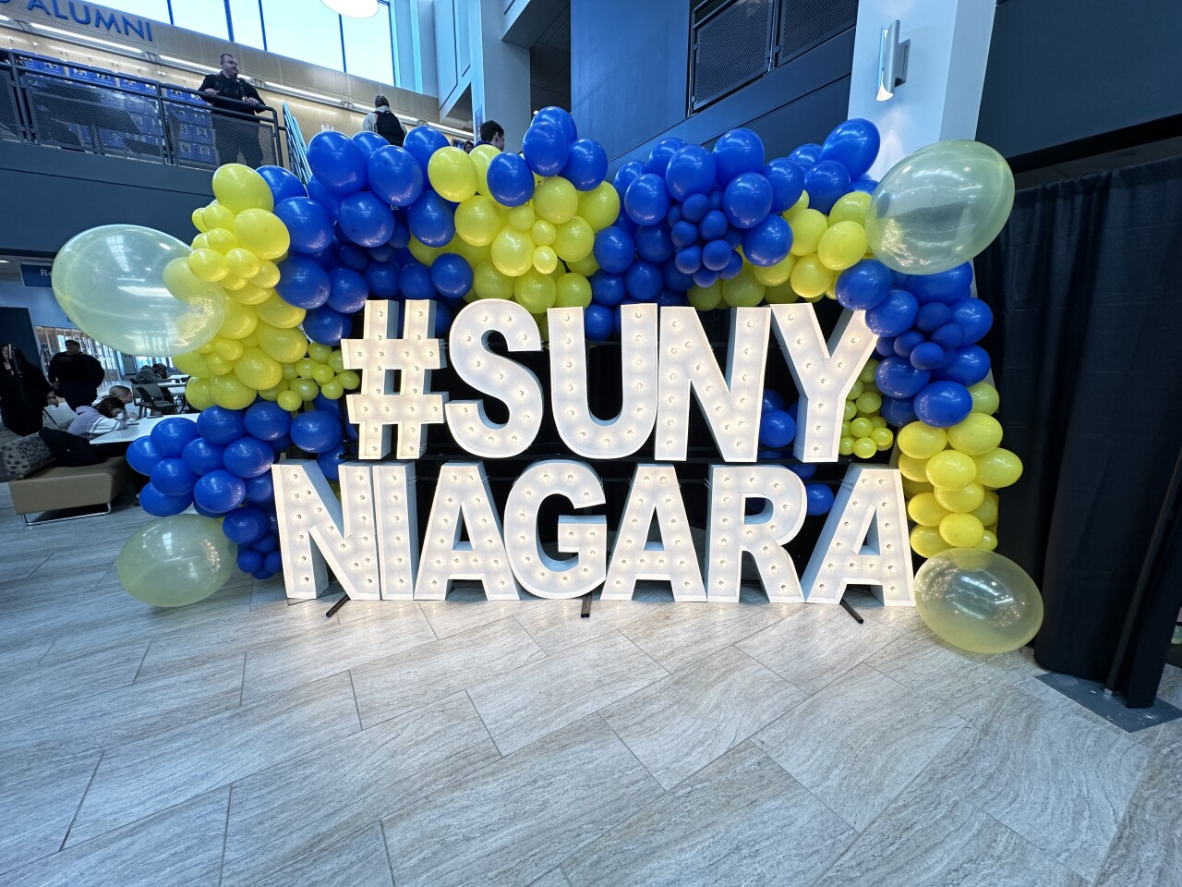
P-TECH Pathways
Mechanical Engineering/Technology
Computer Information Systems/ Science
The Computer Science pathway prepares students with fundamental programming skills and ways to utilize the computer as a problem solving tool. This pathway prepares students for positions in business, medicine, national defense, scientific exploration and more.
The Mechanical Technology pathway prepares the student to pursue a wide variety of career positions including engineering design, product development, laboratory testing, technical sales, technician, manufacturing, and much more.

Slide 8
NFCSD offers 2 PTECH programs You can choose to enter either program
Mechanical Technology and an additional pathway in Engineering
Some of our business partners are:
New York Power Authority
Linde
VOSS Manufacturing, Inc.
Olin
MOOG
Computer Science and an additional pathway in Computer Information Systems
Some of our business partners are:
Niagara Falls Medical Memorial Center
MOOG
VOSS Manufacturing, Inc.
ODOO

Slide 9
PTECH Summer Camp
Mechanical Technology
Computer Science
Morning: Math
Math refresher class to prepare for next year
Focus on problem solving skills with STEM kits
Speakers
Afternoon: Technology
Paper Rockets
Bottle Rockets
Soldering
Electronics
Morning: Computer Science
Website design
App design
Basic programming skills
Afternoon: Math
Math refresher class to prepare for next year
Projects incorporating math concepts ex. Bottle Rockets and Bungee Barbie
Speakers

Slide 10
Application process
After tonight’s presentation and our mini career fair you can determine which program may be of interest to your child
Online applications for both programs will be posted on the Niagara Falls City School District website on Tuesday April 1- Monday May 26, 2025. Once on the site click on the P-TECH tab and on the bottom left are the two applications. Please apply to only one program
Applications will be reviewed and notices of acceptance will be sent in early June
In June each Prep School will host a signing day at which we celebrate students’ acceptance into both P-Tech Programs dates TBD

Slide 11
PTECH Slide Show
Slide Show….

Slide 12
Student Panel
Students from our PTECH Program from NFHS will now speak to you about some of their experiences.

Slide 13
Conclusion
Please join us now for an opportunity for you to learn more about the two P-Tech Programs in the Aux Gym.
We have all our business partners, our higher education partners and teachers as well as students who will share with all of you more about our P-Tech programs
Starting Monday April 1- May 26 the two P-Tech Applications will be available on our NFCSD District Website. Please apply to only one program

